Slide 1

Windows Server and PowerShell
Bert Wolters & Jaap Brasser

Slide 2



Slide 3
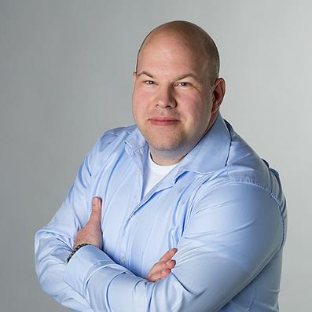



Bert Wolters
Incorrigible Microsoft enthusiast
~ Consultant @ Inovativ
~ BBQ
~ Believer in IT communities
Bert Wolters
b-bewolt@microsoft.com
@bertwolters

Slide 4
What are we going to do?
Basic concepts of PowerShell
Work through examples
Have fun ☺

Slide 5
What do we need?
Windows with WMF 3 or higher
PowerShell ISE
Updated PowerShell help

Slide 6
Check your configuration

Slide 7
Start PowerShell as Admin Set-ExecutionPolicy Unrestricted Update-Help -Force

Slide 8
Agenda for Today
PowerShell fundamentals
Using variables and working with objects
Loops, operators and flow control
PowerShell modules, snap-ins and functions
PowerShell tips from the field
Q&A Session
Conclusion and take away

